Slide 1



SPARK MEMORY MANAGEMENT

Slide 2
This presentation will cover:
Introduction
Types of memory
Static and Unified model of memory management
Memory Contention Types

Slide 3
Introduction
Spark is a memory based data processing framework hence memory plays a central role. Efficient memory usage is key to good performance therefore It is important to understand how spark does memory management

Slide 4
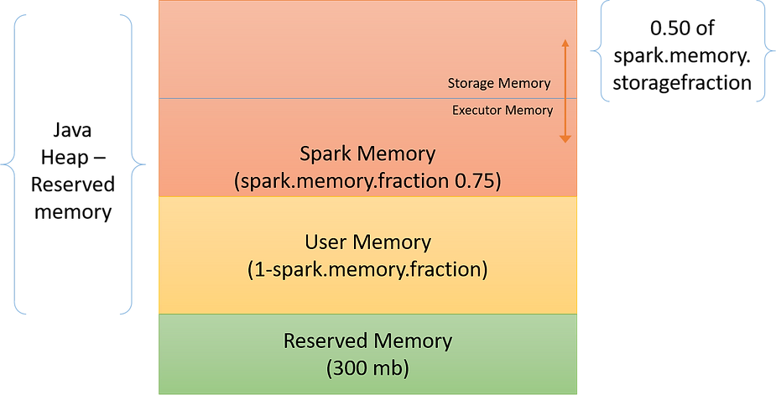
Types of Memory
On heap Memory
Reserved Memory
User Memory
Spark Memory

Slide 5
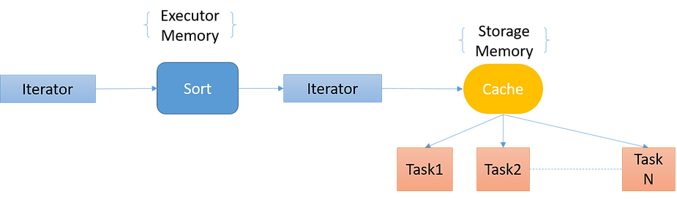
Spark Memory
This is the memory pool managed by Spark. It is divided into two parts:
Executor memory
Storage memory
This is calculated as (“Java Heap” – “Reserved Memory”) * spark.memory.fraction
Boundary between executor and storage memory is set by spark.memory.storageFraction
Executor Memory
Memory used for computation – Shuffle, join, sort, aggregations etc. Its short lived.
Storage Memory
Memory used for storing and caching objects to be reused later. It is for future computation. Its evicted using LRU algorithm.

Slide 6
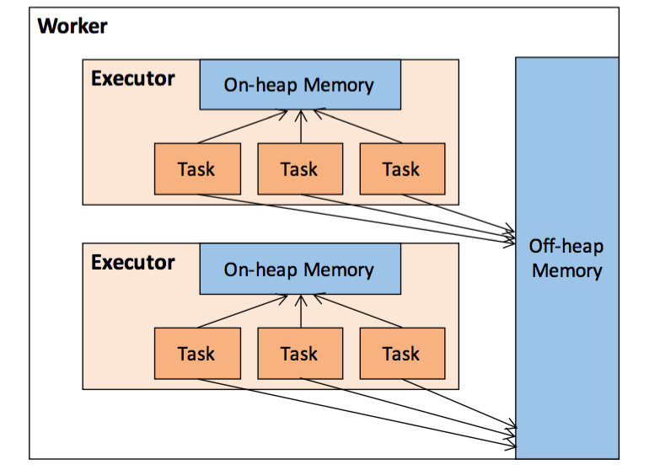
Off heap Memory
Off heap refers to serialized objects, it was introduced in spark 1.6.
By default it’s disabled but can be enabled by the property spark.memory.offHeap.enabled and size can be set by the property spark.memory.offHeap.size

Slide 7
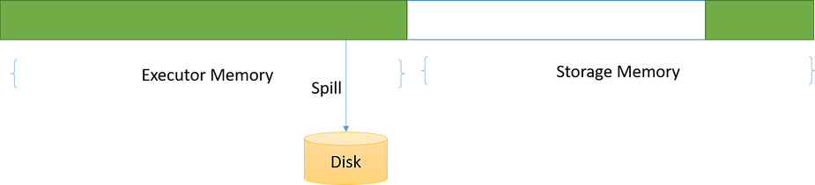
Static and Unified model of memory management
Static Memory Management Model:
In this model, the space used between executor memory and storage memory was predefined and static. Which essentially means that even if either of them doesn’t utilize 100% space allocated to them, that space would remain idle.
Notes:
Advantage - It’s easy to implement
Disadvantage – Even though space is available with storage memory we can’t use it and there is a disk spill since executor memory is full. (vice versa)

Slide 8
Unified Memory Management Model:
Instead of specifying execution and storage memory as two separate chunks, it’s specified as a single unified space that they both can share.
spark.memory.useLegacyMode – this option can be used to divide heap space into fixed-size regions (default false)

Slide 9
Memory Contention Types
Across tasks running in parallel
- Static assignment
If worker node has 4 slots, each task will get one slot and specified memory per slot. (1/4 of total memory). No of slots are fixed irrespective of tasks running.
It is simpler to handle.
- Dynamic assignment
Amount of memory a task gets depends on no of tasks running at one point of time. If a single task is running it can take up all the memory but if another task comes it has to spill to disk and free up memory. This is similar to above scenario but slots are not fixed from the beginning and is decided dynamically.
Notes:
Advantage - It’s easy to implement
Disadvantage – Even though space is available with storage memory we can’t use it and there is a disk spill since executor memory is full. (vice versa)

Slide 10
Across operators running within same task
In this case there is contention between operators inside a single task.
One option that was used in earlier versions of spark was reserving memory pages for each operator but that wasn’t an efficient solution. Later the solution used was cooperative spilling (from spark version 1.6).
Notes:
Advantage - It’s easy to implement
Disadvantage – Even though space is available with storage memory we can’t use it and there is a disk spill since executor memory is full. (vice versa)

Slide 11
Thank you for listening

